Slide 1


FEM 3105
STRESS AND COPING
WEEK 8
FACTORS INFLUENCING STRESS TOLERENCE:
EXTERNAL

Slide 2
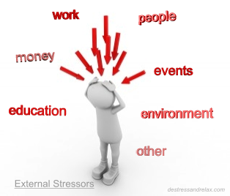
EXTERNAL
FACTORS
EXTERNAL
STRESSORS
External coping resources
Family characteristic
Environment
Support system
Physical Environment
Social Interaction
Organisational
Major Life Events
Daily Hassles
External stressors come from external factors, which are forces that you can't easily control and can have physical and psychological effects.

Slide 3
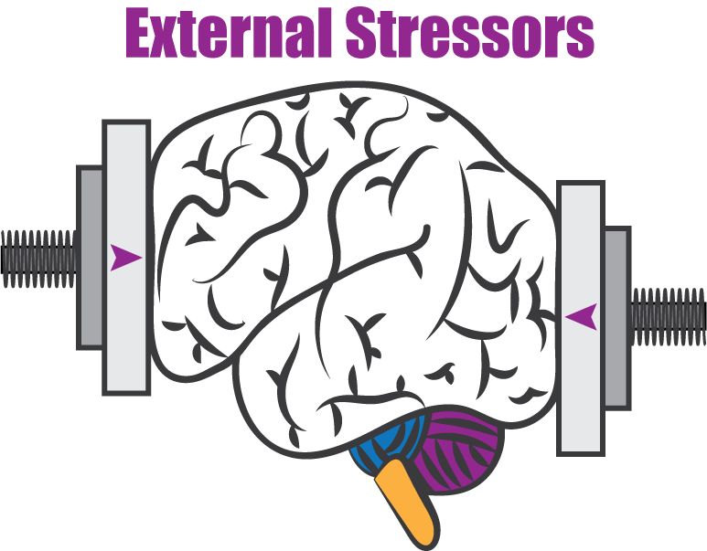
EXTERNAL STRESSORS
PHYSICAL ENVIRONMENT
  Noise
  Bright lights
  Heat
  Confined spaces
SOCIAL INTERACTION
  Rudeness
  Bossiness
  Aggressiveness by others
  Bullying
ORGANISATIONAL
  Rules
  Regulations
  “Red - Tape”
  Deadlines
MAJOR LIFE EVENTS
  Job loss
  Loss of a loved one
  Divorce
DAILY HASSLES
Are out of your control. These are stressful things that happen in your surroundings, your environment.
The key difference between external and internal stressors is that external stressors are unlikely to be in your control. The only way to reduce the stress caused by external stressors is to change the way you react to the stressors. You control the effect it has on your life.
If left untreated, everyday stresses can lead to chronic stress.
Recognizing a problem, identify and understand the sources of your stress are the first steps towards solving it.
If you feel depressed or hopeless, seek help from your doctor or a mental health professional right away. The earlier you seek treatment, the greater the chances of successfully coping with stress.

Slide 4


WHAT IS SOCIAL SUPPORT?
  The term “social support” often appears in discussions of relationships. Social support means having friends and other people, including family, on whom we can rely in times of need or crisis to give you a broader focus and positive self-image.
  Social support enhances quality of life and provides a buffer against adverse life events.
  Material and psychological resources that can be obtained from others in one’s social support network.
  A broad definition of social support is the "resources provided by others" (Cohen and Syme, 1985)
  Gottlieb (1983) - interpersonal coping resources. Being supportive has less to do with the 'kinds' of support provided and more to do with how people interact with and relate to one another .

Slide 5

OTHER DEFINITIONS OF SOCIAL SUPPORT...
“ information leading the subject to believe, he is cared for and loved, esteemed, and a member of a network of mutual obligation.”
- Cobb -
“perception that one is cared for and loved or has a confident or intimate friend”.
- Bloom -
“ the degree to which a person’s basic social needs are gratified through interaction with others.”
- Thoits and Kaplan et al.-
“may be seen as the emotional, instrumental and financial aid that is obtained from one’s social network.”
- Berkman -
Overall it appears that all the definitions imply some form of positive interaction or helpful behaviour provided to someone in need of support.

Slide 6
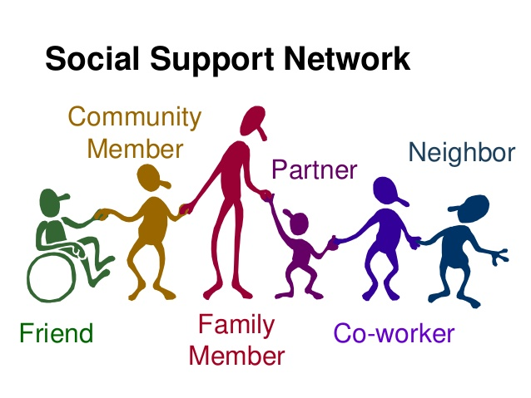
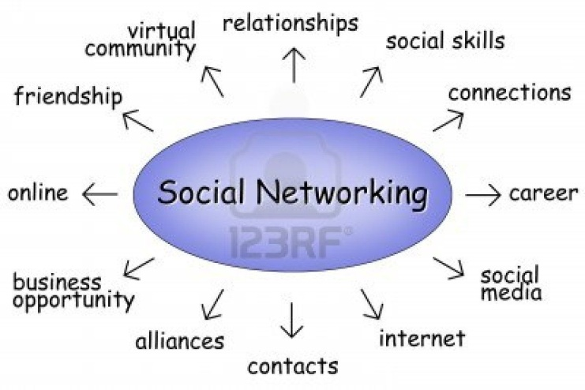
WHAT IS SOCIAL NETWORK ?
Social Networks
  A network of social interactions and personal relationships.
  Use of Internet-based social media sites to stay connected with friends, family, colleagues, customers, or clients
  As “ the vehicle through which social support is provided.” – Langford
  Refers to people’s social ties to one another, and the structure of those social ties.
  Social networking can have a social purpose, a business purpose, or both, through sites like Facebook, Twitter, LinkedIn, and Instagram.
  Depending on the network, social networks may or may not be supportive or beneficial.

Slide 7

ACTIVITY….SCL
“Discuss what kind of support you give and received?”
“How important is social support to you?”

Slide 8
TYPES OF SOCIAL SUPPORT
Social support is one of the important functions of social relationships. Social support is commonly categorized into four types of behaviours.
Four Types of Supportive Behaviours:
    Emotional Support:
        Includes provision of care, love, trust and empathy as well as respect and admiration.
        This type of support is the most abundant, and far out numbers all other types of support.
        Related to Attachment Theory- that people are the happiest and most effective when that they have one or more trusted persons they can confide in.
        Emotional support are actions that show esteem, affect, trust, concern & listening
        denotes what is done to facilitate the person's capacity for emotion-focused coping (House, 1981).
    Instrumental Support
        Includes providing tangible good and services, such as money, groceries, completing work that was assigned to someone else, use of one’s car etc.
        Material support are actions such as doing something or giving time & energy
        denotes what is done to enhance the person's capacity for problem-focused coping (House, 1981).

Slide 9

    Informational Support
        Involves providing information or advise to another in a time of need, especially problems solving situations.
        The richest source of this form of support is often from professionals. E.g., Health Professionals, Lawyers, Accountants, etc.
        However informational support can also be provided by friends and family.
        denotes advice, guidance and other such means of backing up both problem-focused and emotion-focused coping (House, 1981).
    Appraisal Support
        Often included as part of informational support.
        Involve the communication of key information that is relevant in self-evaluation situations.
        Appraisal support are honest personal feedback from others (House, 1981).

Slide 10
The ways in which types of social support differ may best be illustrated using an example.
Example: A 39-year-old graduate student and mother of 2 young children is feeling overwhelmed after being diagnosed with cancer.
TYPES OF SOCIAL SUPPORT
CONSTRUCT | DEFINITION | APPLICATION
Emotional | Expressions of empathy, love, trust and caring | Close friends and family members provide hope and a listening ear
Instrumental | Tangible aid and service | Her husband decides to work from home 2 days per week to baby-sit the children while she attends her chemotherapy
Informational | Advice, suggestions, and information | Doctors provide facts about cancer and guidance during the treatment process Her mother offers advice about her own chemotherapy treatment 3 years prior
Appraisal | Information that is useful for self-evaluation | A close friend of 15 years reminds her of all of the qualities that equip her to "beat" cancer (to encourage an accurate assessment of her current situation)

Slide 11
CONT…TYPES OF SOCIAL SUPPORT
Each of these four types of social support appear to play a role in protecting and helping person who is receiving the support.
  Structural vs. Functional
  The structural: "how many friends, colleagues, family relationships" you have.
  The functional aspect would refer to what these do.
  In essence you can have lots of friends but not interact with them and this may not be very useful.
  A functional view of social support argues that there are specific types of support that are beneficial in specific types of situations.
  Two types of support can be highlighted: emotional and practical. Emotional support refers to the feeling of being loved, cared for and esteemed by others, whereas practical or Instrumental support refers to the assistance with tasks.
However, for these support elements to have a positive effect on health and well being it appears 3 additional components are needed:
        Social Networks- previously defined.
        Social Embeddedness- the connectedness one has with others within their social network (how deep or strong the relationship is).
        Social Climate- the personality of the environment (is it a supportive type of environment).
It is important to note that large social networks does not mean this large network will provide large amounts of support.

Slide 12
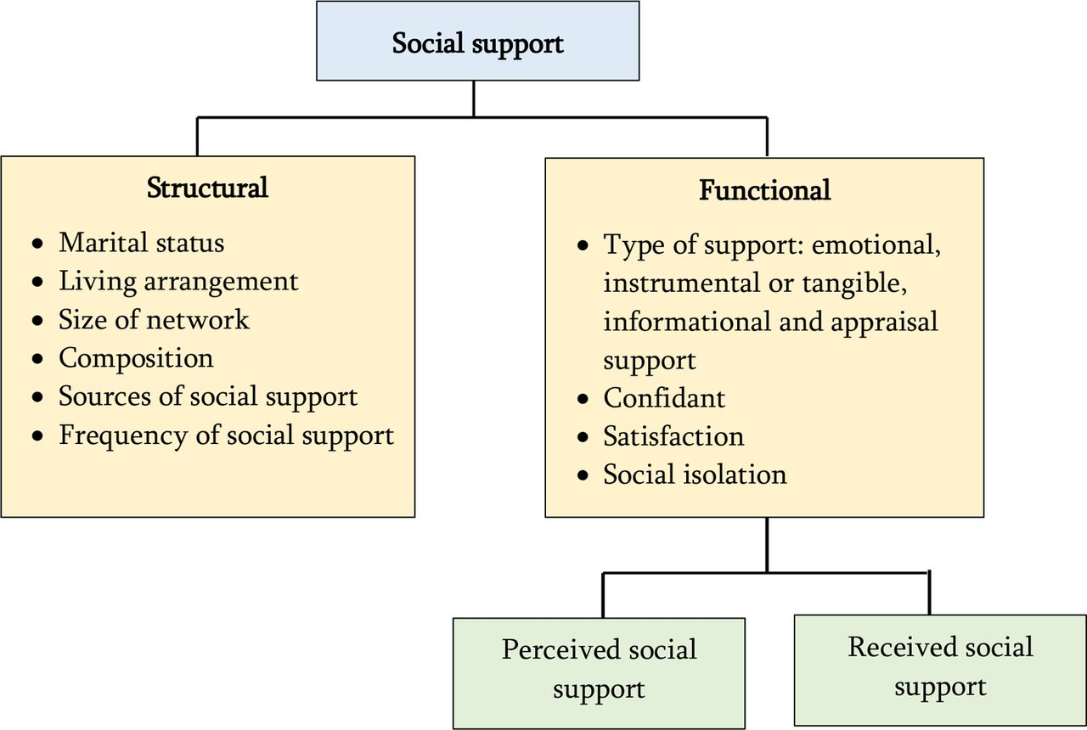
CONT…TYPES OF SOCIAL SUPPORT
They also enable an exchange of reciprocal supportive actions. This may further increase one’s level of perceived support – the sense that one belongs to a social group and that help will be there if and when it is needed.
Perceived vs. Received Support
  Perceived support refers to how individuals perceive friends, family members and others as sources available to provide material, psychological and overall support during times of need.
  Received support refers to support transactions or actions that actually occur (e.g., advice or reassurance) offered by providers during times of need.
  Thus, the actual support received cannot be objectively observed and counted; rather the recipient has to be asked how it was perceived.

Slide 13
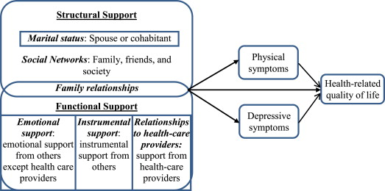
CONT…TYPES OF SOCIAL SUPPORT

Slide 14
Social Support and Health
There is very little doubt that social support and social ties have positive influences on health.
The earliest indications that social support and social interaction was related to health was shown by Durkheim’s suicide studies:
    He found that being integrated into a society appeared to be critical to health and well-being individuals who lacked these social ties were likely to be isolated, lonely and in an extreme state of anomie.
    All of which increased the risk of suicide and premature death – a trend that social epidemiologists would confirm.
Effects of Social Support on Health
Studies have shown social support has many positive effects on health and well-being, including:
    Reduced risk of death due to heart attack or other circulatory diseases
      Men who never married, or live alone, had a higher risk of heart disease.
    Reduced risk of cancers.
    Faster recovery.
    Fewer complications during pregnancy.
    Keeping patients in medical treatment and increasing compliance with prescribed medications.
    Increased levels of self-worth and esteem.
    Facilitates coping and adaptation to change.
    Reduced anxiety levels.
    Overall, increased life satisfaction.

Slide 15
How Support Works
There are many hypotheses on how social support may promote health.
  One is that social support may have some effect on neuroendocrine pathways - possibly through stress reduction.
  Or through promoting compliant behaviours in patients, causing them to more diligent with the treatment and medication regimes - by being good patients
However, many studies suggest that support may not contribute directly to health outcomes, but rather “buffer” or protect health during times of high stress
    A study conducted be Cohen and Wills found a relationship between social support and psychological well-being only in the presence of stress.
    It is believed that social support increases one’s level of psychological well-being by allowing individuals to feel like that have better control over their stress.
    Social support may be a primary coping mechanism.
Social networks may also influence health more directly by providing access to information needed in making decisions regarding health issues.
In addition, information support may come with some form of advice, especially where information is coming from friends or family members who have been through the same or a similar situation.

Slide 16

THE END
THANK YOU ☺

